Slide 1


Greenland warming the last 140 years
Mario Janus
23th September | PARIS
DAFT July 2022

Slide 2


Business case
Greenland warming over the last 140 years
Greenland warming is a big issue due the big ice mass it holds and the melting of it can or will have a big impact to coastal areas arround the world.
Is climat change effecting the temperature in Greenland?
The analyses of the data shows that climate change is indeed also increasing the temperature. It
What factors could be responsible for increasing temperatures?

Slide 3
Plan
Investigation of my business case
Look for data related to my business case
Data collection
Data cleaning and exploratory analysis
Decide on database type
Build my ERD Model
Create database and import data
Write queries for insights
Model
Conclusions

Slide 4
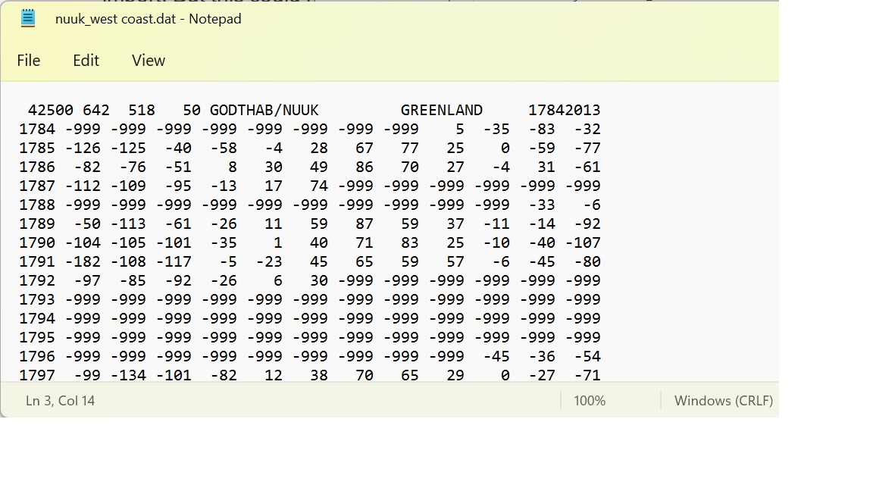
About data
Data was recorded monthly from 1784 to 2013 that were collected from historical year books and was provided by the Danish Meteorological Institute
The temperatures are regressed values and not real temperatures
they calculated the monthly mean temperatures (Tm) in the Yearbooks with the following formula: Tm = (2 * T8 + 2 * T14 + 5 * T21) / 9 where T8, T14 and T21 are the monthly mean temperatures measured at 08:00, 14:00 and 21:00 o’clock local time respectively.
Notes:
created by the University of Dayton - Environmental Protection Agency, stored in their Average Daily Temperature Archive, source university American National Climatic Data Center
first data source: Climate Watch. created 2018 by a Washington DC based institution named: World Resources Institute, Climate Watch offers open data, visualizations and analysis to help policymakers, researchers and other stakeholders gather insights on countries' climate progress.
The PRIMAP-hist national historical emissions time series (1850-2014). V. 1.1, collected and created by Gtschow Johannes, Jeffery Louise, Gieseke Robert and Gebel Ronja in 2017 as part of the potsdom institute for climat impact research
UNFCCC data: Greenhouse Gas Inventory Data - Detailed data by Party created by UNFCCC in 2017, released by the United Nations climat change institut
The World Resources Institute is a global research non-profit organization established in 1982 with funding from the MacArthur Foundation under the leadership of James Gustave Speth. WRI's activities are focused on seven areas: food, forests, water, energy, cities, climate and ocean.

Slide 5
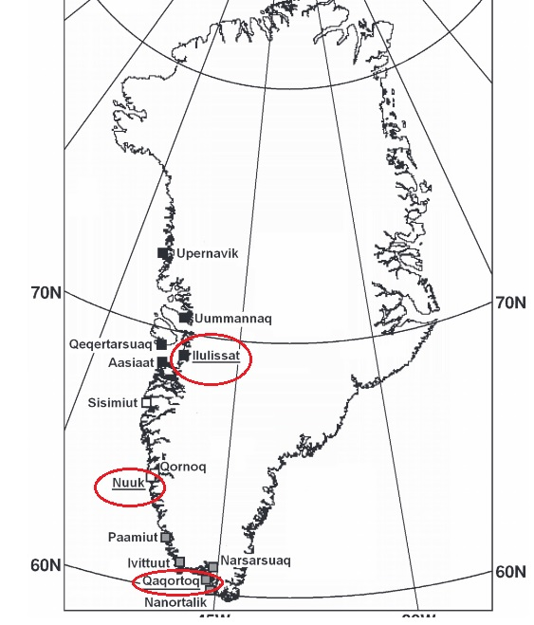
Metadata
Displays the average temperature at over the last 140 years from 3 sites in Greenland.
The datas are from the 3 sites, which are Nuuk, Ilulissat and Qaqortoq. Nuuk is situated the in the north, Ilulissat is in the middle and Qaqortoq is in the south. All sites are situated at the coast, but Ilulissat is a bit more inland in a protected bay
Notes:
.datset2 → All of the numeric data is given in Metric tons of carbon dioxide equivalent or MTCO2e.

Slide 6
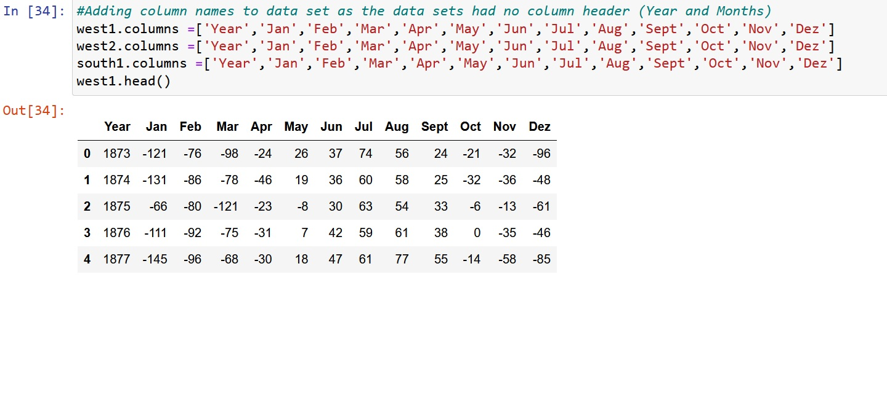
Data cleaning
Datasets contains monthly average temperature from January till Dezember.
Removed first line (description line) from datasets via text editor, to make it easier to import the file with Pandas
.dtypes shows all values are integers
Datasets contained no column names, only columns with pure numbers
Added column names for Year and Months for better analysing
The data from 1784 till 1882 contains a lot of “empty” values, which are represented by -999 as value.
Splitted data into new dataframes with start year 1873, as since this timeframe the data contains no empty values in all 3 data sets.

Slide 7
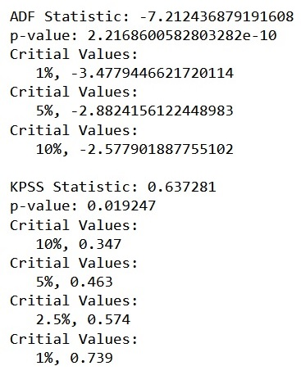
Exploratory Data analysis
Checked data for outliers via boxplot. Data showed only 1 to 4 outliers per dataset. I kept them as they are part of normal climate fluctuation.
Checked if time series is stationary or none stationary with ADF and KPSS test. ADF test showed that series is stationary, but KPSS showed serie is none-stationary. P-value from ADF is very close to zero, contrary to KPSS were the value is 0.02. Due this we can assume the serie is instead stationary.

Slide 8
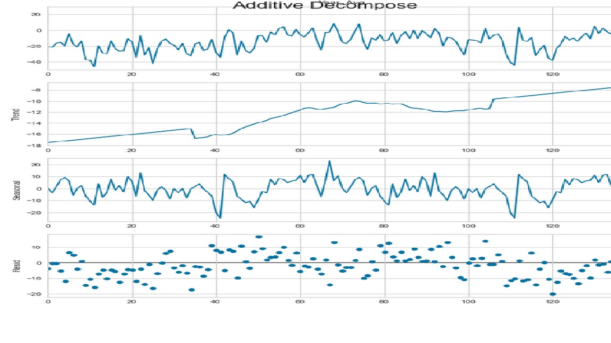
Exploratory Data analysis
Also performed for seasonal decomposition for average temperature for the years to check for trends and seasonality
Additive decompose has been used, as mulitplicative decompose is not possible with this dataset, as they contain negative values too.
Results show that there is a clear upward trend, but there is no seasonal pattern

Slide 9
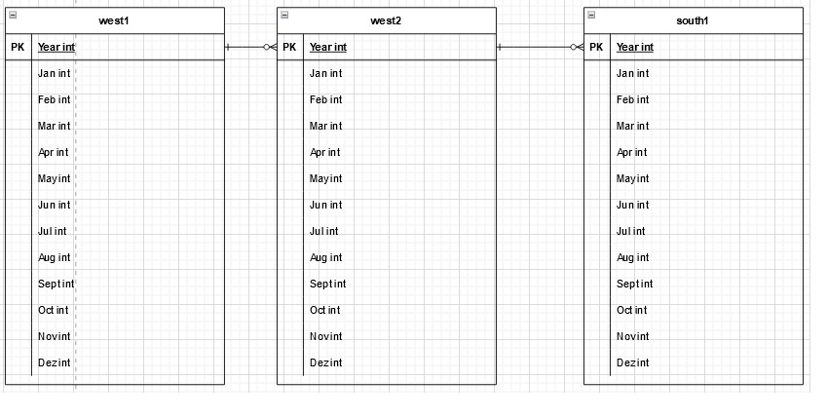
Database selection
There are 4 types of databases: hierarchical database, network database, object-oriented database and relational database. Each datebase type has it advantages and disadvantages and store data in a different way. I descripted this a little bit in the report. As for my database I chose MySQL as I don’t had any special requirements and my data doesn’t contain many features. MySQL is also free to use and it relatively easy to make SQL queries with it, especially with my kind of data.
ERD
As your already saw, my datasets dont contain many features or parameters, just year and monthly temperatures. Therefore the database is very simple and used to stored the data in MySQL for future use and to use it for some SQL queries for some insights via Python and plotting.

Slide 10
ERD
As your already saw, my datasets dont contain many features or parameters, just year and monthly temperatures. Therefore the database is very simple and used to stored the data in MySQL for future use and to use it for some SQL queries for some insights via Python and plotting.

Slide 11
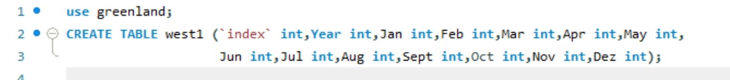
Database creation
As you saw in the entity diagram, I chose simple table names for the location, as the real location names would be to cumbersome for SQL queries. West1 is Nuuk, West2 is Ilulissat and south1 is Qaqortoq. The table columns have been created in MySQL itself and then the dataframes from Python have been exported to MySQL. For the import of the frames a temporary index column has been created in each SQL table, because otherwise the import would fail. After the import the temporary column has been deleted again, as each table should only contain one index column.
Table creation:

Slide 12
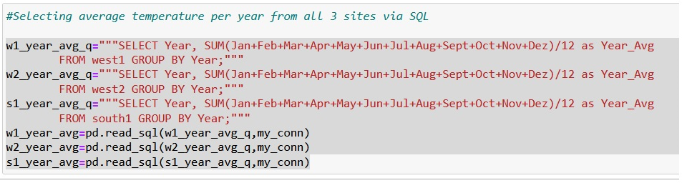
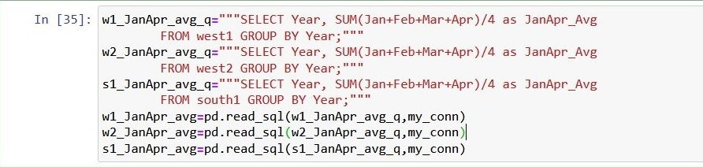
Database queries Yearly average temperature Seasonal average temperature for all 3 sites

Slide 13
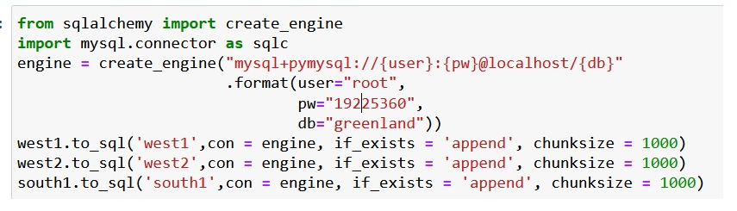
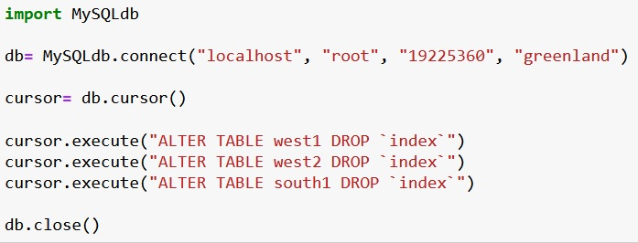
Database creation
Importing of dataframes to MySQL:
Deleting temporary index column:

Slide 14
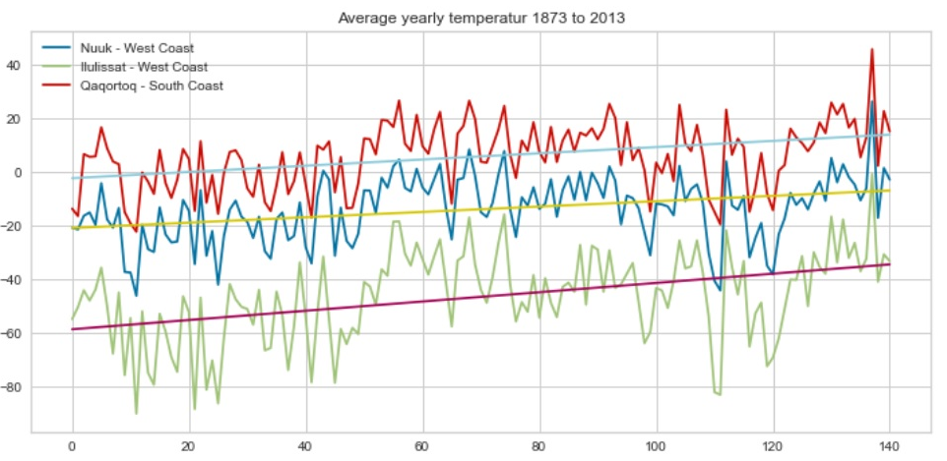
Insight queries
I also performed some SQL queries in Python and plotted them to give some insight of the temperature over the last 140 years in Greenland. Here I calculated the yearly average over the last 140 year with SQL for all 3 sites and plotted them:
As you can see from the linear regression line, the temperature increased slowly over the decades. The south is warmer as the temperatures are generally warmer in the south and also the Gulf stream plays maybe a role.

Slide 15
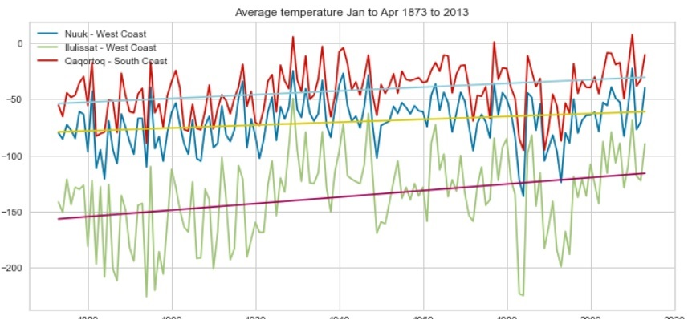
Insight queries
The Ilulissat site is the coldest site of the 3 sites, as it lays in a protected bay. The other sites are directly at the coast. If you look closely, then you will see two big drops in the early 1980s and 1990s. This drops are probably related to the eruption of Mount St. Helen (in the north of USA) in 1980 and Pinatubo (Philippines) in 1991. This big eruptions blew a huge amount of sulfur dioxide in the atmosphere, which has a cooling effect on the climate. I also looked at the season average over the last 140 years with a SQL queries. For winter I took the months Jan to Feb as this is coldest months and for summer I chose May till Aug. This is the query and the results:

Slide 16
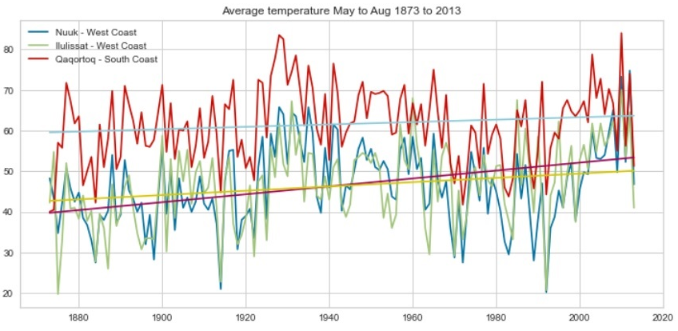
Insight queries
Notes:
Solar hydro and

Slide 17
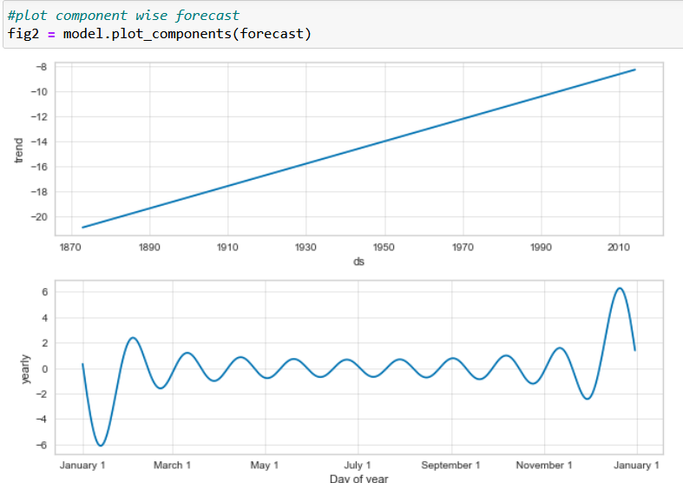
Model
For the model I chose Prophet from Meta, as it is was simple to use and I ran into some time problem in the end. Unfortunately the Output doesnt tell much, probably because of the regressed values, but it shows at least a clear upward trend.

Slide 18

Choose a data base
I decided to use a SQL database
allows me to use my cleaned and converted data frames
perform queries on a small level.
link the different tables with each on their relational basis.
do not care about object-oriented programming
writing longer queries is acceptable
The most important factor is to be able to work with the output of my data cleaning process: structured data
The relational database I will use is MySQL
Notes:
Centralized: stores data at a centralized database system + access from different locations + authentication process Distributed: distributed among different database systems + database systems are connected via communication links Relational: based on the relational data model + which stores data in the form of a table (row +column) + uses SQL for storing, manipulating Object-oriented: uses the object-based data model approach for storing data Why SQL: ability to store the data collected + ability to create queries and retrieve information + ability to create relations or not

Slide 19
Choose a data base
As you can see the winter (Jan to Apr) shows nearly the same pattern as the yearly average for the 3 sites over the last 140 years. The interesting thing is, that summer temperature in all 3 sites do move more closely together, especially since 1960 as seen in the second plot. Also the temperatures in the south increase more in summer then at the other 2 sites, so the glaciers there are at risk to melt faster.
Conclusion
The analysis shows that Greenland gets indeed more and more warmer since the last 140 years. Especially the south is heating more then rest of Greenland and the ice melting there will probably accelerate in the future. The analysis also shows that big volcanic events can influence the temperature in Greenland, even when the eruptions happen 1000ths of kilometers away from Greenland.

Slide 20
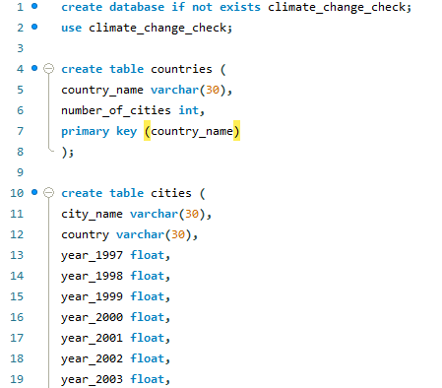
Database creation

Slide 21
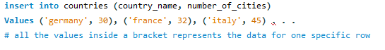
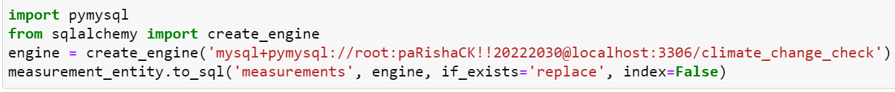
Data importation into Database
3 different ways to import data into tables
Method above, outdated and time consuming
table data import wizard method
Two tables too large
imported the pymysql and sqlalchemy library to set up a connection between MySQL local server and my jupyter notebook and import the data into my database with created engine.

Slide 22
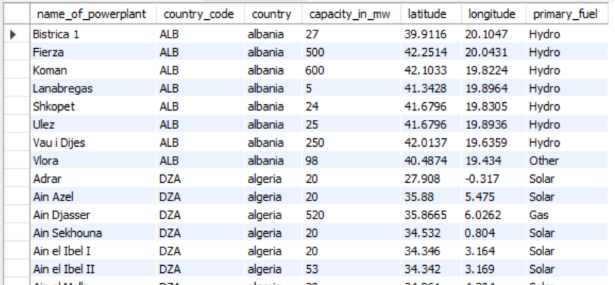
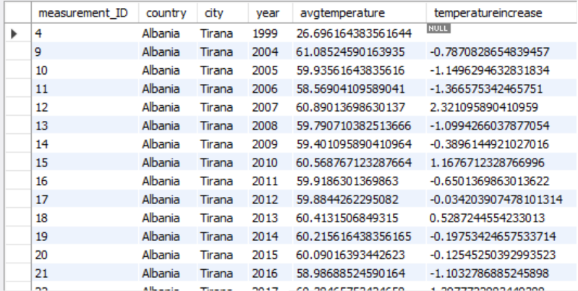
Tables

Slide 23
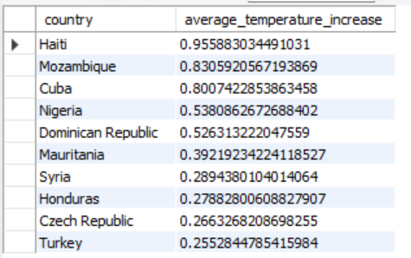
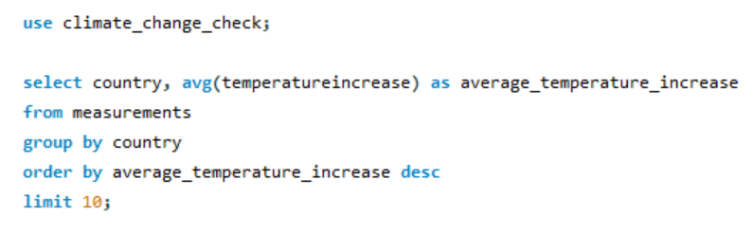
Insight queries
checking the baseline question of my business case: does the data reflect increasing temperatures over the last couple of years and which countries had the highest average temperature increase
used the measurement table, grouped countries, aggregated average temperature increase for each
Displayed top 10 results

Slide 24
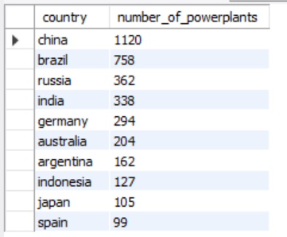
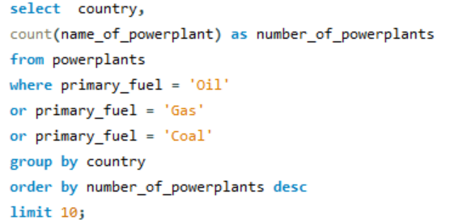
Insight queries
Checking for correlation between temperature increases and my two factors
started with power plants table
grouping by countries, aggregating the number of power plants whose primary fuel type is carbon based
such as e.g. natural oil or coal.
On the right top 10 countries with the highest number of such power plants.

Slide 25
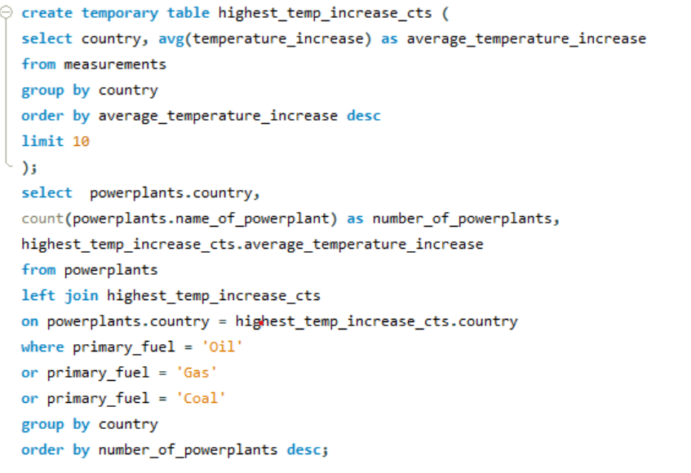
Insight queries
Using a left join, aggregated the results of this query and the previous query
Check if those countries are among countries which use carbon based fuels powerplants.
Results:
Seven are among those countries having carbon based using powerplants
Turkey and check republic among top 25

Slide 26
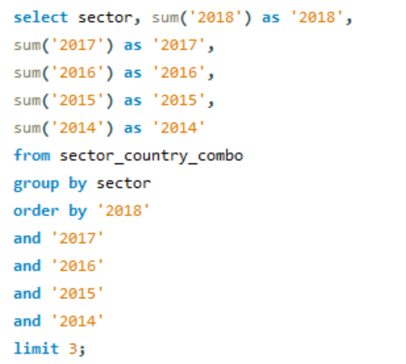
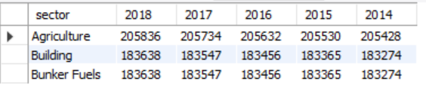
Insight queries
Check my second factor: is there a correlation between how dominant economic sectors with high greenhouse gas emissions are represented in countries and their temperature increase
Which economic sectors have the highest greenhouse gas emissions?
Using the sector country combo table, grouping by sector summing the values for every sector in the last 5 years

Slide 27
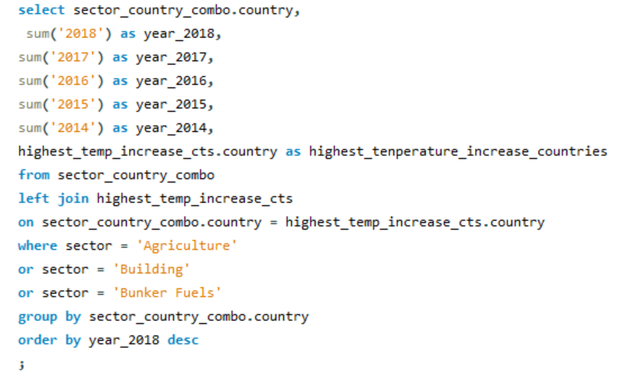
Insight queries
Using same table, grouping by country, summing all of the values that have been collected for the emissions of those 3 sectors shown before for the last five years, ordering values descendingly.
Check: are top ten temperature-increasing countries are among those having data on these 3 sectors?
Joined a temporary table displaying those top ten countries
Results:
All top 10 countries among the those we with data on sectors with high GHG emission
5 of them being among the top 40

Slide 28
Conclusions
Against expectations, exploratory analysis has revealed there has not been a general temperature increase over the past years
rather a form of up and down cycle with temperatures falling and rising every few years
on a country level there has been temperature increases, reaching up to 1 degree per year on average
Regarding the given data, conclude that there are correlations between the factors defined in my business case and the increasing temperatures of the countries with the highest temperature increases
keep in mind: these conclusions are all based on the given data sets used only
Notes:
For example the fact that over 150 cities recorded in the data were based in the US might have affected the output of my analysis regarding the general temperature increase over the years. If I would have had more time, further steps could have been taking into account more data measurements about different countries so there would be an equal amount of data for each country proportionally.

Slide 29
Climat change through the eyes of data
Ferdinand, Leube
Questions?

